Slide 1
Levenshtein Distance Metrics for Text

Slide 2
String distance metrics: overview
Term-based (e.g. TF/IDF as in WHIRL)
  Distance depends on set of words contained in both s and t.
Edit-distance metrics
  Distance is shortest sequence of edit commands that transform s to t.

Slide 3
String distance metrics: Levenshtein
Edit-distance metrics
  Distance is shortest sequence of edit commands that transform s to t.
  Simplest set of operations:
    Copy character from s over to t
    Delete a character in s (cost 1)
    Insert a character in t (cost 1)
    Substitute one character for another (cost 1)
  This is “Levenshtein distance”

Slide 4
Levenshtein distance - example
distance(“William Cohen”, “Willliam Cohon”)
s
W | I | L | L | I | A | M | _ | C | O | H | E |  | N
W | I | L | L | L | I | A | M | _ | C | O | H | O | N
C | C | C | C | I | C | C | C | C | C | C | C | S | C
0 | 0 | 0 | 0 | 1 | 1 | 1 | 1 | 1 | 1 | 1 | 1 | 2 | 2
alignment
t
op
cost

Slide 5
Levenshtein distance - example
distance(“William Cohen”, “Willliam Cohon”)
s
W | I | L | L |  | I | A | M | _ | C | O | H | E | N
W | I | L | L | L | I | A | M | _ | C | O | H | O | N
C | C | C | C | I | C | C | C | C | C | C | C | S | C
0 | 0 | 0 | 0 | 1 | 1 | 1 | 1 | 1 | 1 | 1 | 1 | 2 | 2
gap
alignment
t
op
cost

Slide 6
Computing Levenshtein distance - 1
D(i,j) = score of best alignment from s1..si to t1..tj
D(i-1,j-1), if si=tj //copy
D(i-1,j-1)+1, if si!=tj //substitute
D(i-1,j)+1 //insert
D(i,j-1)+1 //delete
= min

Slide 7
Computing Levenshtein distance - 2
D(i,j) = score of best alignment from s1..si to t1..tj
D(i-1,j-1) + d(si,tj) //subst/copy
D(i-1,j)+1 //insert
D(i,j-1)+1 //delete
= min
(simplify by letting d(c,d)=0 if c=d, 1 else)
also let D(i,0)=i (for i inserts) and D(0,j)=j

Slide 8
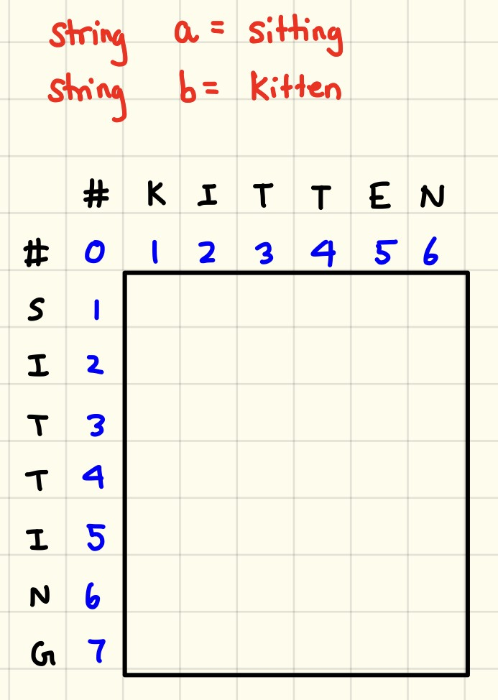
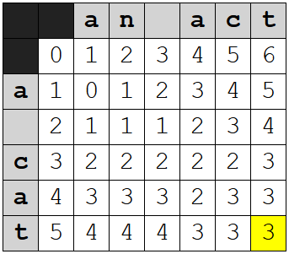

Slide 9
Computing Levenshtein distance - 3
D(i-1,j-1) + d(si,tj) //subst/copy
D(i-1,j)+1 //insert
D(i,j-1)+1 //delete
D(i,j)= min
 |  | C | O |  | H | E | N
M |  | 1 | 2 |  | 3 | 4 | 5
C |  | 1 | 2 |  | 3 | 4 | 5
C |  | 2 | 2 |  | 3 | 4 | 5
O |  | 3 | 2 |  | 3 | 4 | 5
H |  | 4 | 3 |  | 2 | 3 | 4
N |  | 5 | 4 |  | 3 | 3 | 3
= D(s,t)

Slide 10
Computing Levenshtein distance – 4
D(i-1,j-1) + d(si,tj) //subst/copy
D(i-1,j)+1 //insert
D(i,j-1)+1 //delete
D(i,j) = min
 |  | C | O |  | H | E | N
M |  | 1 | 2 |  | 3 | 4 | 5
C |  | 1 | 2 |  | 3 | 4 | 5
C |  | 2 | 3 |  | 3 | 4 | 5
O |  | 3 | 2 |  | 3 | 4 | 5
H |  | 4 | 3 |  | 2 | 3 | 4
N |  | 5 | 4 |  | 3 | 3 | 3
A trace indicates where the min value came from, and can be used to find edit operations and/or a best alignment (may be more than 1)

Slide 11
Computing Levenshtein ratio
Ratio = ((len(s)+len(t)) - distance[row][col]) / (len(s+len(t))

